Slide 1

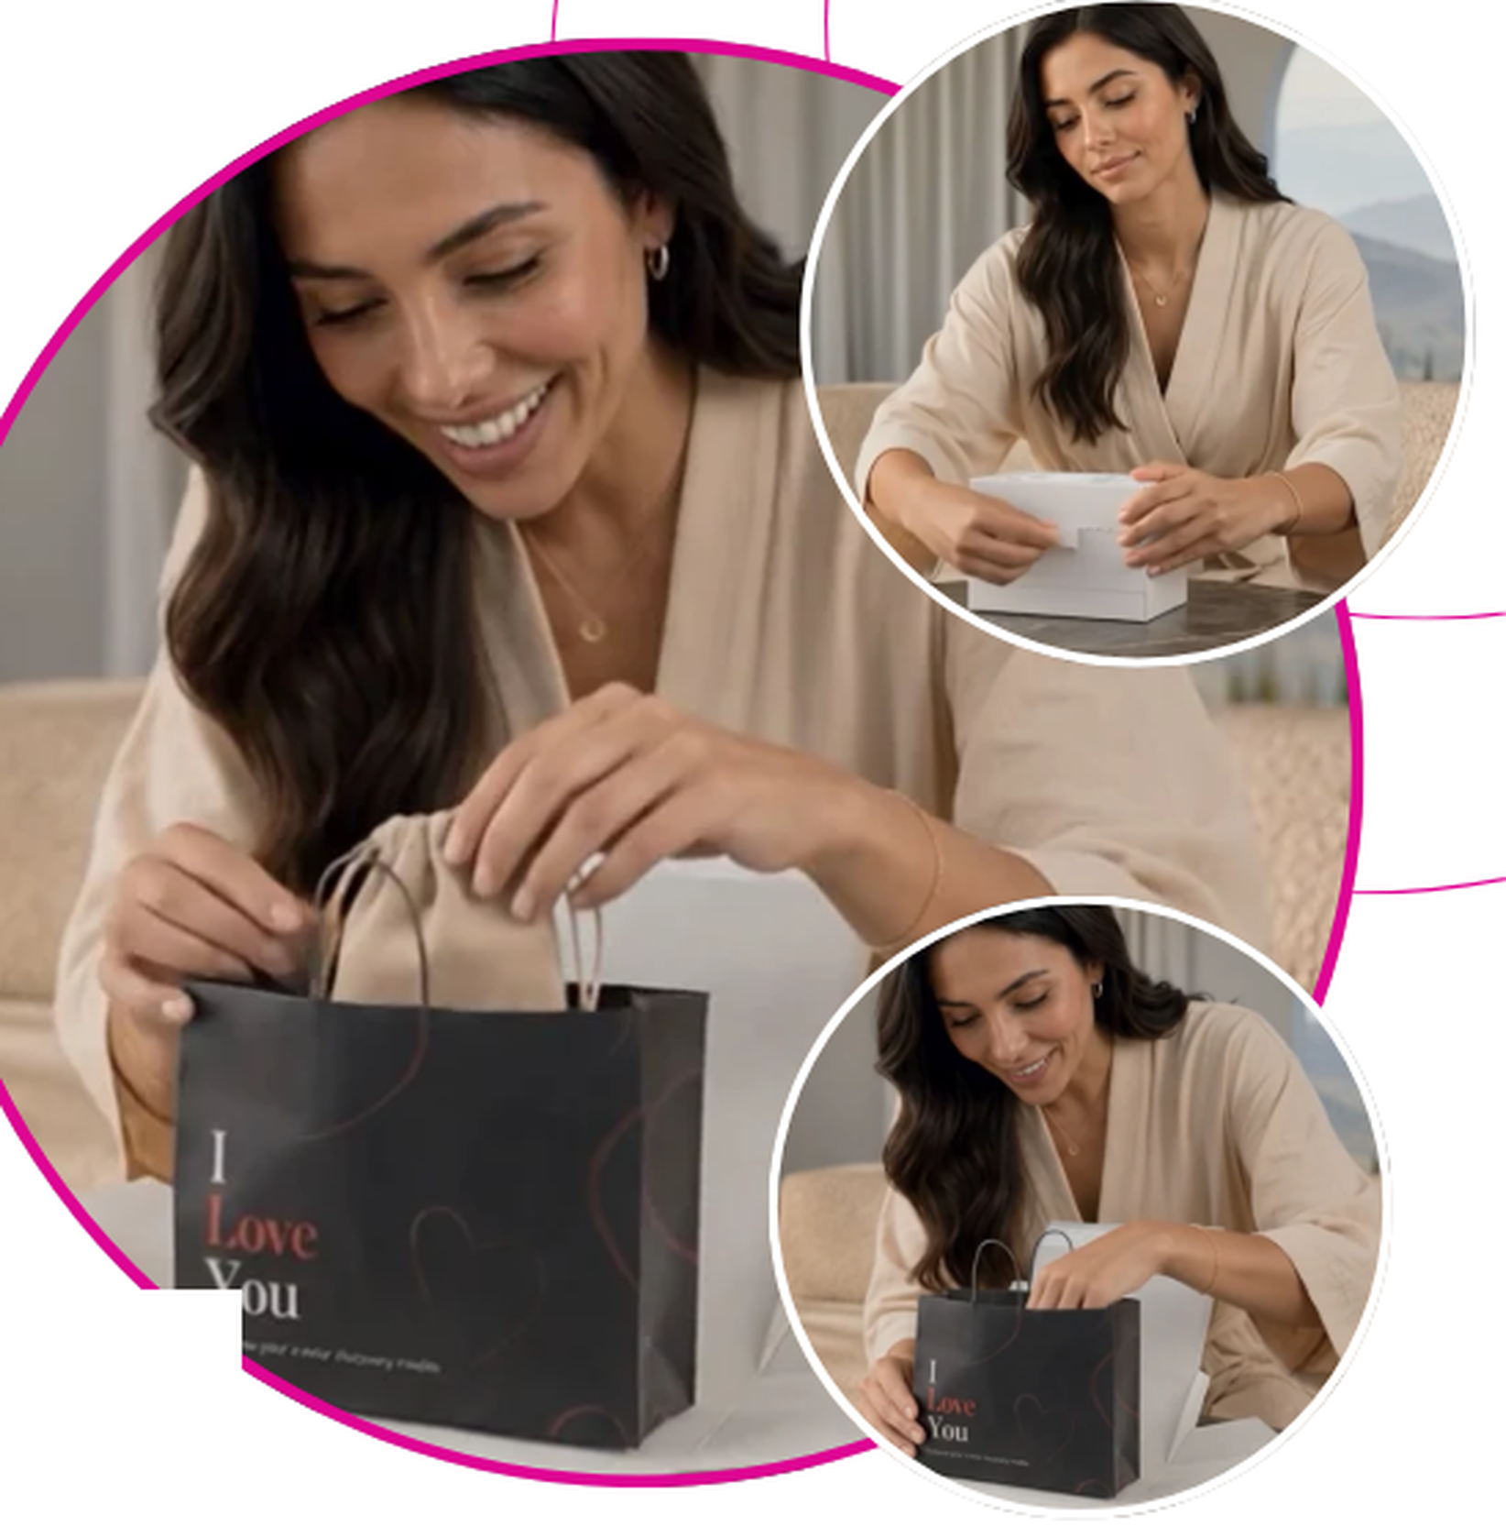

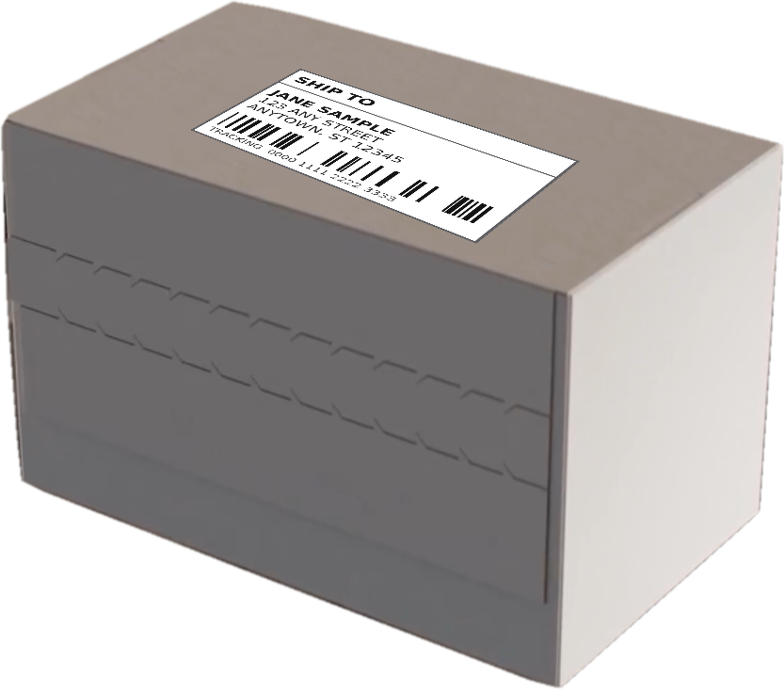




FORTUNE PACK™ | PREMIUM DTC PACKAGING
Fortune
Pack™
RETAIL-GRADE PACKAGING FOR
YOUR ONLINE BRAND
How does your customer
experience the Fortune Pack?
1. Box arrives at your customer’s door.
2. Pull the seal strip to reveal the branded bag.
3. The bag separates from the box, ready to reuse.
SCAN ME TO SEE
FORTUNE PACK IN ACTION
ARRIVES SEALED
What Your Customers Expect
PREMIUM PACKAGING DRIVES
MEASURABLE GROWTH.
74%
40%
55%
0
of U.S. consumers say packaging design influences their purchasing decisions.
more likely to repurchase after premium branded packaging.
of shoppers share unboxing experiences on social media.
branding on the outside. Nothing in transit says what is inside, and it arrives tamper-evident.
Ipsos, 2024
Dotcom Distribution
Dotcom Distribution
Fortune Pack
Why Brands Choose Fortune Pack™
BUILDS
BRAND LOYALTY
ELEVATES
UNBOXING
PROTECTS
YOUR PRODUCTS
SUSTAINABLE
& MEMORABLE
A high-quality, reusable bag keeps your brand in customers’ hands longer.
A premium, gift-like experience made for social media and influencer content.
Designed insert and packaging reduce damage and returns.
Eco-friendly materials and a functional bag customers will actually reuse.
ShipFromStores · Amy Cohen amy@shipfromstores.com · Rob Kaminski rob@shipfromstores.com

