Slide 1

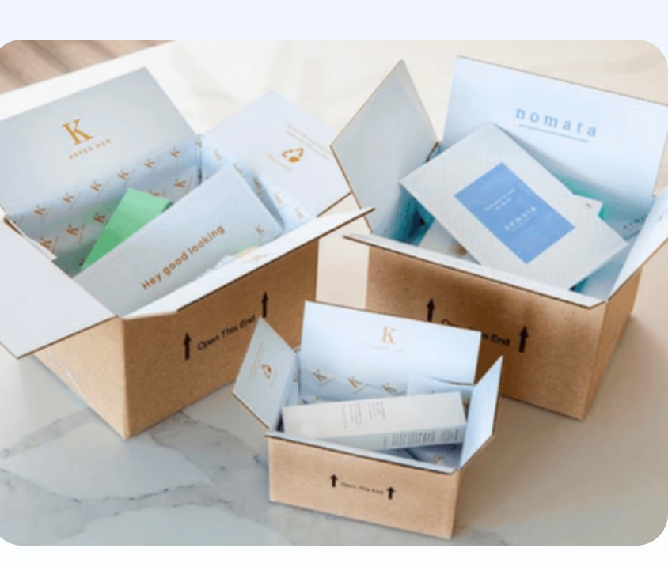
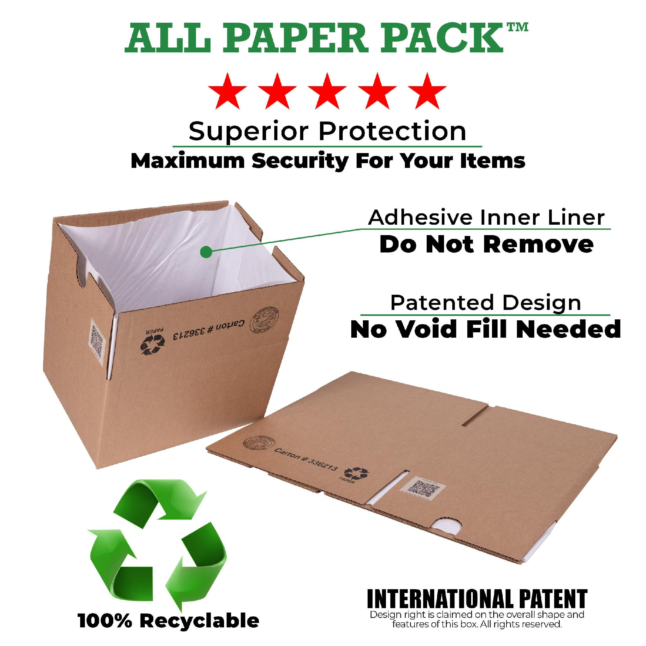
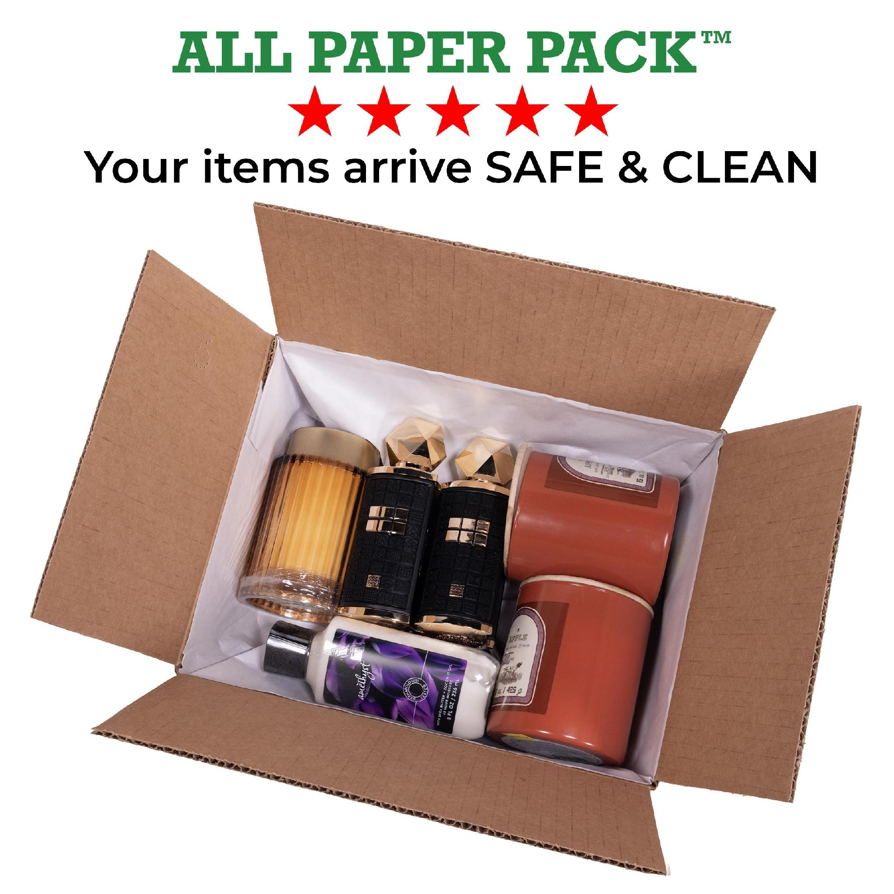
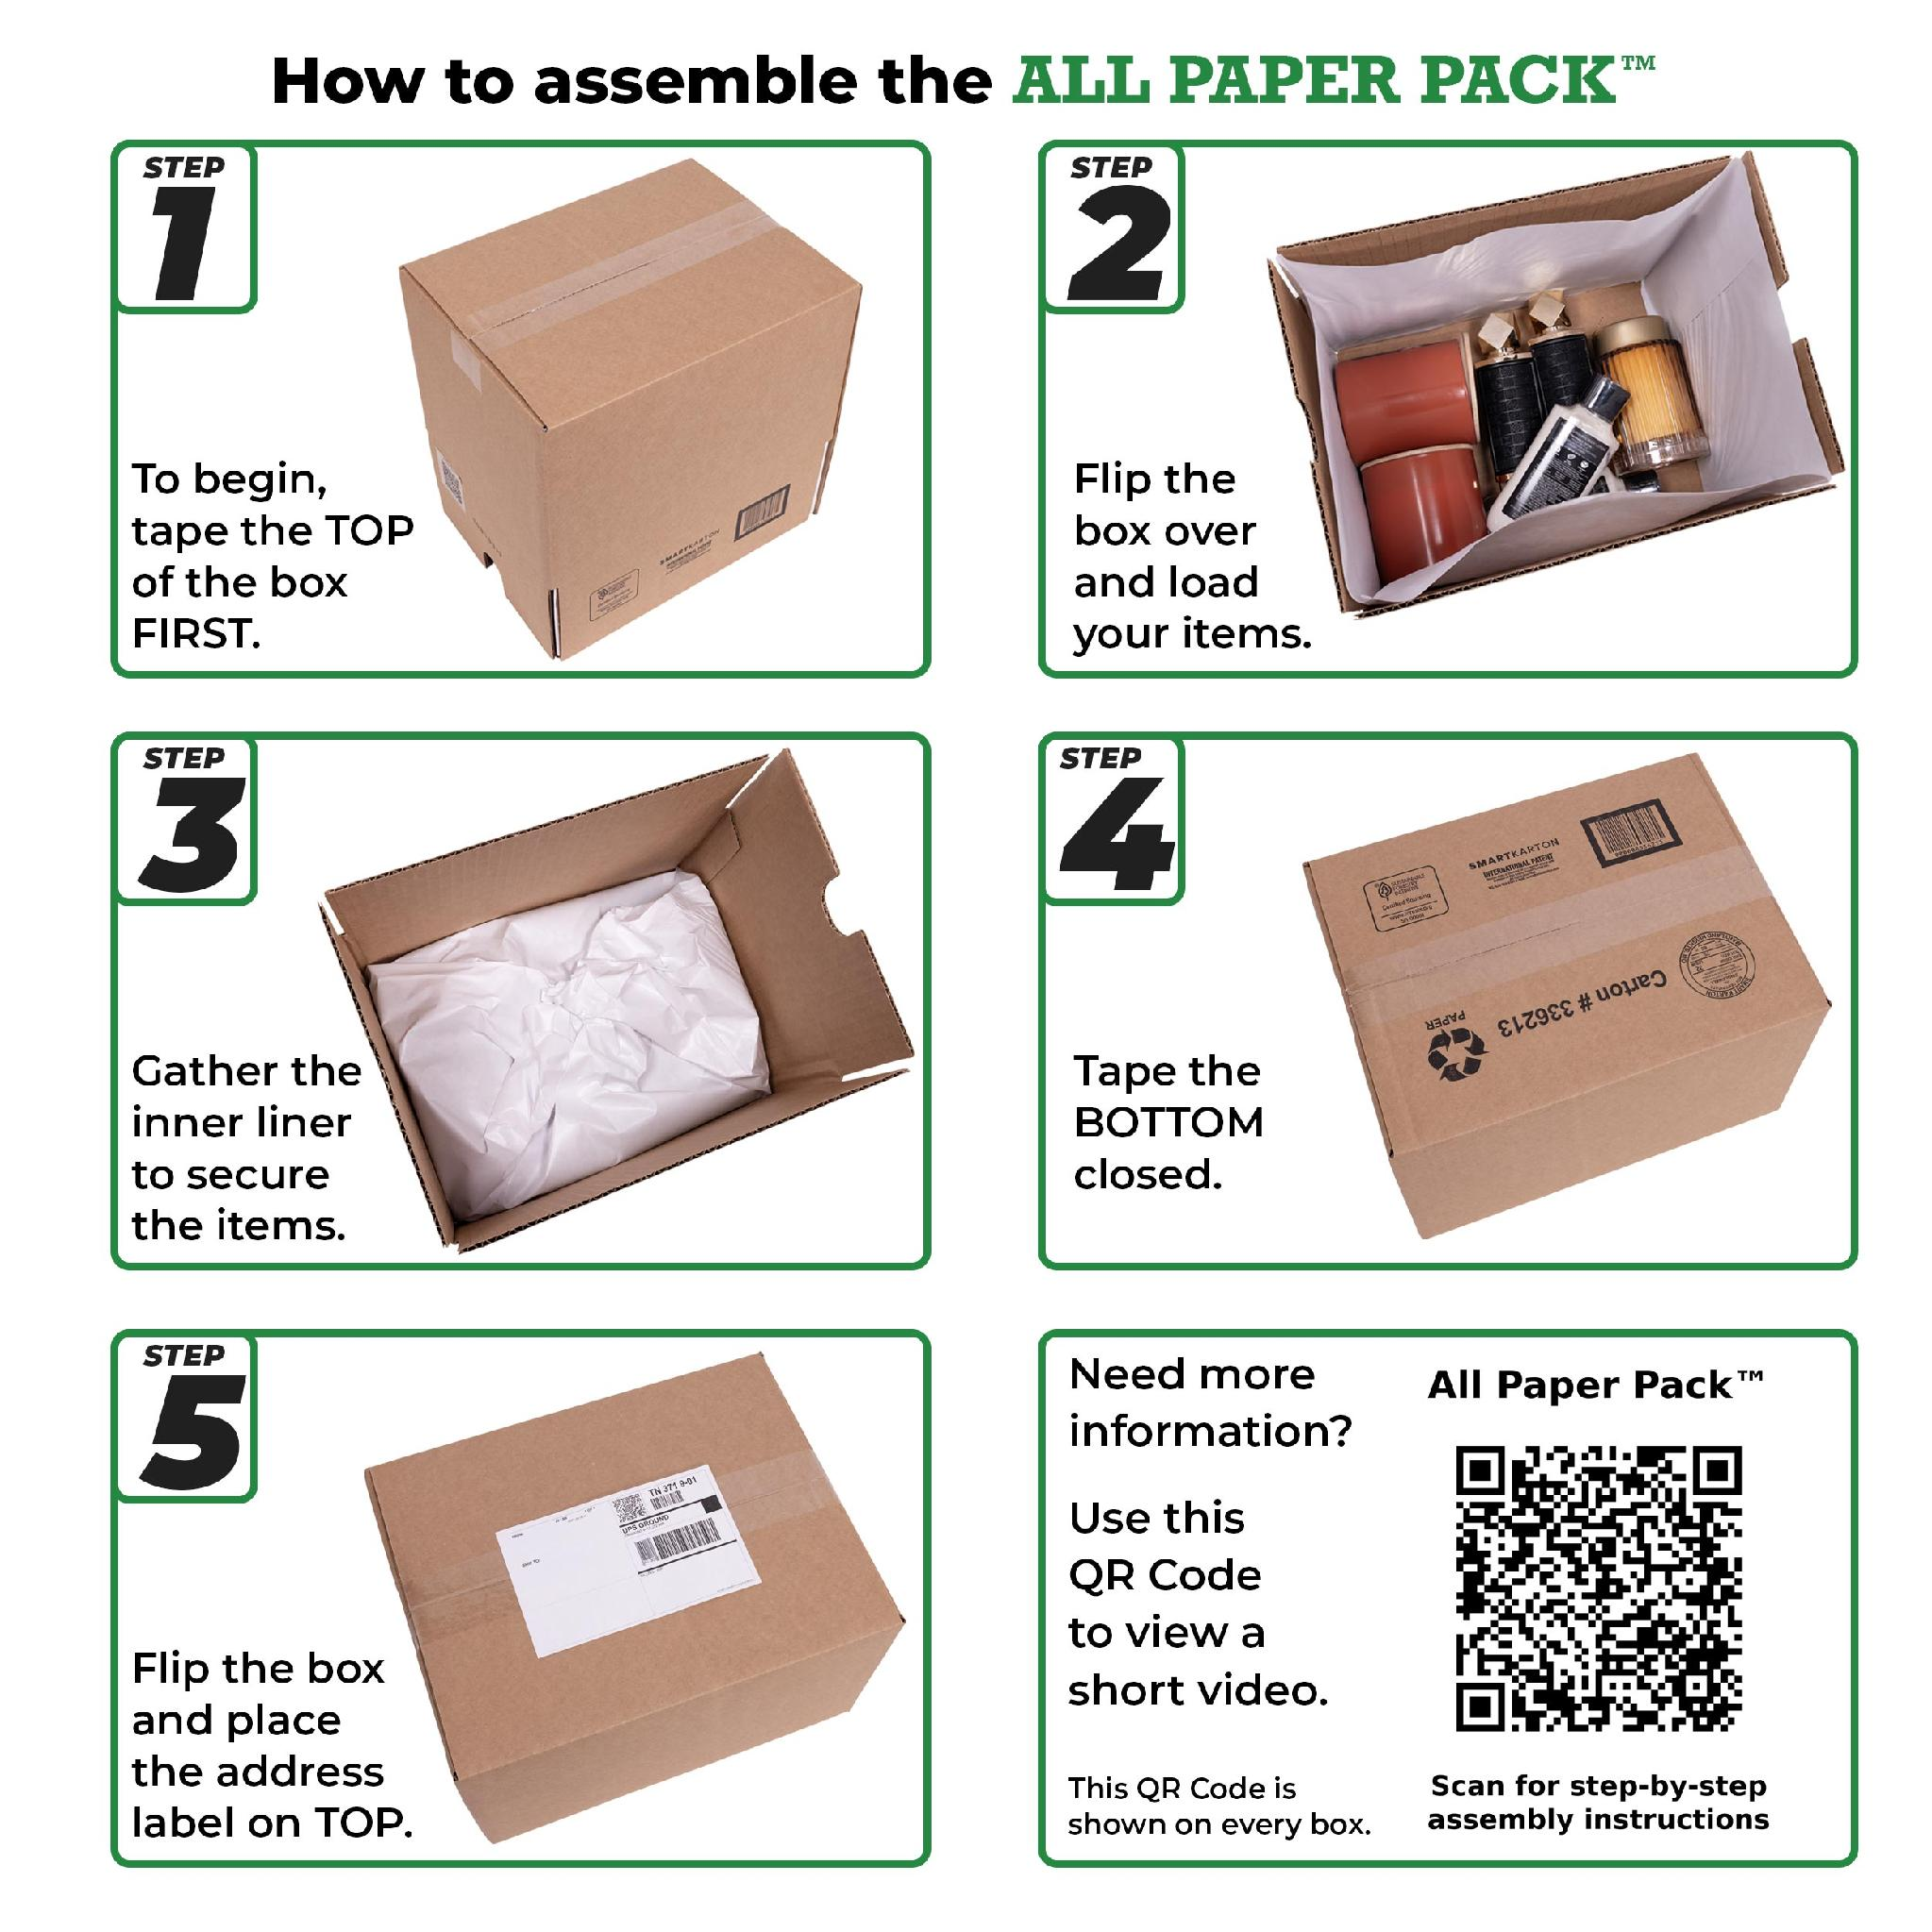





ALL PAPER PACK™ · DTC & RETAIL
Less labor.
Better unboxing.
Void fill leaves the pack station entirely — nothing to buy, store, stage, or dispense. The same order packed in about a third less time, arriving with a premium, on-brand unboxing, and no new equipment.
THE LABOR SAVINGS
35%
Up to 40%
$0
faster — 51 → 33 sec
lower labor cost
new equipment
Typical ROI payback in under 90 days.
Timed side-by-side comparison — watch it in the Battle of the Boxes demo. Results vary by order profile and station layout.
THE PRODUCT
ZERO
100%
5 STEPS
void fill needed
paper, recyclable
simple assembly
nothing to buy, store, or reorder
nothing for customers to throw away
tape · load · gather · tape · label
TWO SIZES
Battle of the boxes
10" × 6" × 4" and 12" × 9" × 7" · Sold in 25-packs
See the timed test
Talk to us about volume.
OR START WITH A 25-PACK
More orders out the door without adding headcount.
Samples, pricing, and a pack-station walkthrough.
No minimum · No contract · Same box we ship at pallet volume
shipfromstores.com
Amy Cohen amy@shipfromstores.com
Rob Kaminski rob@shipfromstores.com
Amazon
Walmart
eBay
TikTok

